Slide 1
Redesigning interface
Team Details
211701054 Soumiya D S (635)

Slide 2
Problem Statement
User experience is a necessary element to be thought when an interface is created, also to be considered when it is updated. An interface that facilitates the experience of a user, as per the convenience of the user tends to increase the number of usability of the interface higher compared to the similar kind of interfaces of any other similar brand. Addressing the challenges considering the needs of users, technological constraints, and the evolving landscape of digital interactions. The goal is to create enhanced user experience design ensuring the success of digital product being considered.

Slide 3
Objectives
Maintaining a consistent and coherent user interface across these diverse platforms poses a significant challenge, resulting in disjointed user experiences.
Develop UX designs that prioritize inclusivity, ensuring accessibility for users with varying abilities, language preferences, and cultural backgrounds. Implement features and design elements that cater to a broad user demographic.
Keeping track of packages for the international orders, special vouchers for the future purchases, color friendly interface for people with various eye condition.
Editing the existing fonts and changing the color palate and elements positionings.

Slide 4
Literature Survey on Existing models(Design)
S.No | Title of the paper/Year of publication | Methodology Proposed | Limitations
1. | Cultural Dimensions in Web Design: A Cross-Cultural Analysis | Enhancing usability for all cultural people. | The possibility of assumed guidelines being only hypothetical.
2. | USABILITY AND USER EXPERIENCE: DESIGN AND EVALUATION | Usability testing and focusing on the user oriented product. | Notions of not considering a large population.

Slide 5
Literature Survey on Existing Models(Design)
S.No | Title of the paper/Year of publication | Methodology Proposed | Limitations
5. | The Ethics of User Experience Design | It proposes the idea of how the designers should have empathic point of view in user centered design. | The area of ethic ranges from providing complete freedom for users, to making all the decisions for them
6. | Personalization and User Customization | Personalization and User Customization on basis of user engagement. | Significant data to be collected, analyzed, for tailoring customer experience. Collecting data is time-consuming and resource-intensive

Slide 6
Literature Survey on Existing models(Design)
S.No | Title of the paper/Year of publication | Methodology Proposed | Limitations
3. | A User Experience Design Process in Mobile Applications Prototypes: A Case Study | Investigate research focused on UX design principles for mobile apps. Explore challenges and solutions specific to mobile UX. | Small Screen Size, Single Window which causes people to only view few important information at a time/
4. | The User Centered Design (UCD) and User Experience Design (UXD) Practice In Industry: Performance Methods and Practice Constraints | Surveys on how UCD and UXD has been implemented in the industry. | Lack of outreach and constraints to the practice of UCD and user experience design (UXD)

Slide 7
Survey Summary
The study from the surveys concludes that the objective of delivering an experience for the user to interact with the interface with an ease. Users are of various types, each user has his or her own preference of the interfaces. The majority of respondents recognized the impact of user-centric design on usability, user engagement, and the overall success of digital products. . The interaction of the user with the existing interface has to observe a difference, interfaces have to be tailored as per the convenience of the users. The adaptivity of the interface for a user based on the personalization and customization. Overcoming the technological constraints and evolving digital landscape. While challenges in achieving a holistic approach were acknowledged, the results underscore the industry's commitment to prioritizing user experience in the design process.

Slide 8
It proposes the idea of how the designers should have empathic point of view in user centered design. The area of ethic ranges from providing complete freedom for users, to making all the decisions for them Personalization and User Customization/2022 Personalization and User Customization on basis of user engagement. Significant data to be collected, analyzed, for tailoring customer experience. Collecting data is time-consuming and resource-intensive

Slide 9
FUTURE SCOPE The future of UI/UX app development is poised for remarkable growth and innovation, driven by emerging technologies and evolving user preferences. One significant trend shaping the landscape is the integration of artificial intelligence (AI) and machine learning (ML) into user interfaces. These technologies enable personalized experiences, predictive analytics, and automation of repetitive tasks, leading to more intuitive and efficient user interactions. Augmented reality (AR) and virtual reality (VR) are transforming the way users engage with digital content, opening new avenues for immersive experiences across various industries. UI/UX designers are exploring innovative ways to integrate AR/VR elements into applications, particularly in gaming, education, and retail sectors, to create compelling and interactive user experiences. In conclusion, the future of UI/UX app development is characterized by innovation, inclusivity, and ethical responsibility. UI/UX designers who embrace emerging technologies, user-centric design principles, and ethical practices will drive positive user experiences and shape the future of digital interactions.

Slide 10
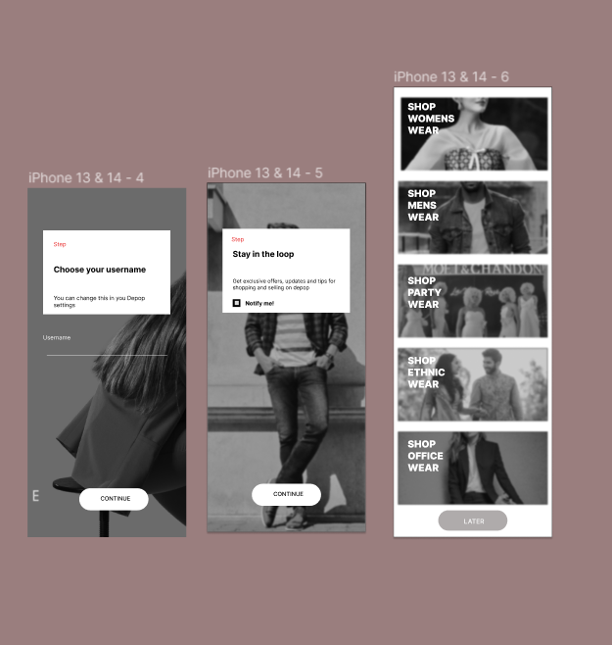
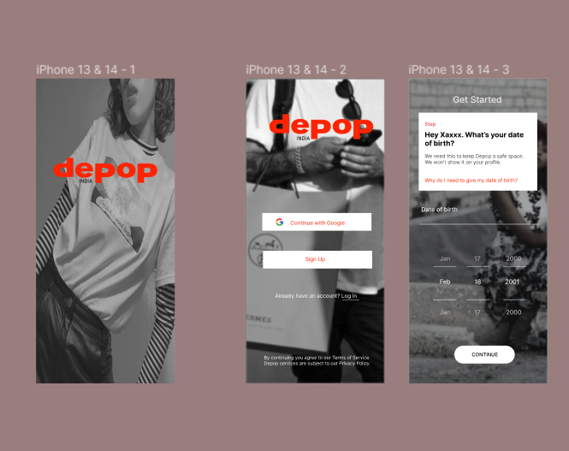
IMPLEMENTATION

Slide 11

